Slide 1
Final Project
Blue Team -
Luis Acevedo,
David Lago,
Susana Correia,
Zarneisha Browning

Slide 2






Technologies, lang., tools used

Slide 3
The Purpose of Choosing Covid Data
For this group project we choose to analyse Covid-19 data. After cleaning and analysing the data used right from CDC website, the group decided to answer the following question:
Based on feature, what attributes are most likely to contribute to COVID-19 deaths?

Slide 4
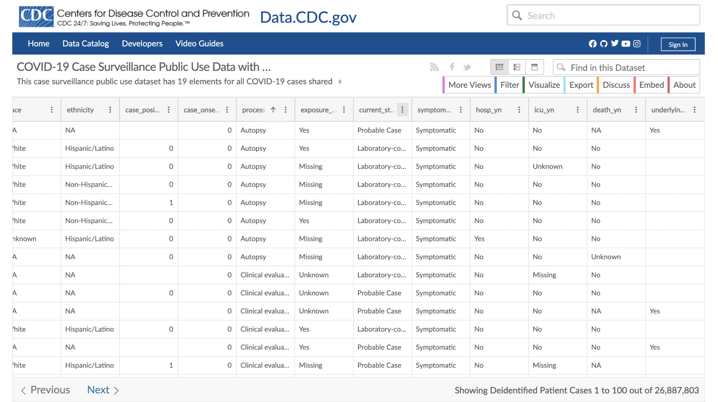
Raw Data from Data.CDC.gov

Slide 5
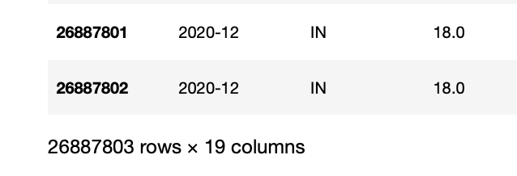
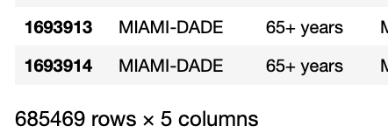
Questions we hope to answer
What features will accurately predict mortality rate
What features are good and worth exploring
How does real world data affect telling a data story
VS

Slide 6
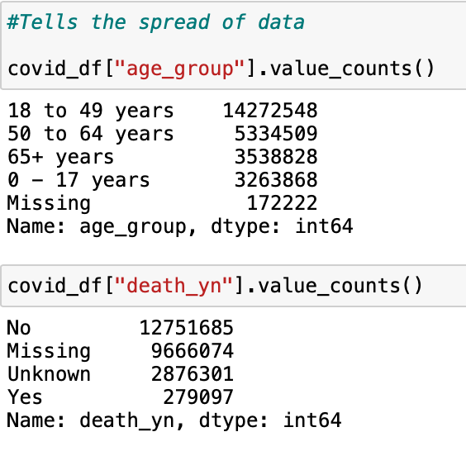
Challenges Working with Data
Missing Data
Unknown, Missing, and Null Values
Inherent Bias in Data
Certain counties missed in florida
The way features were categorized
Data not present in certain features
Too Much Data
Lots of features with little information in them

Slide 7
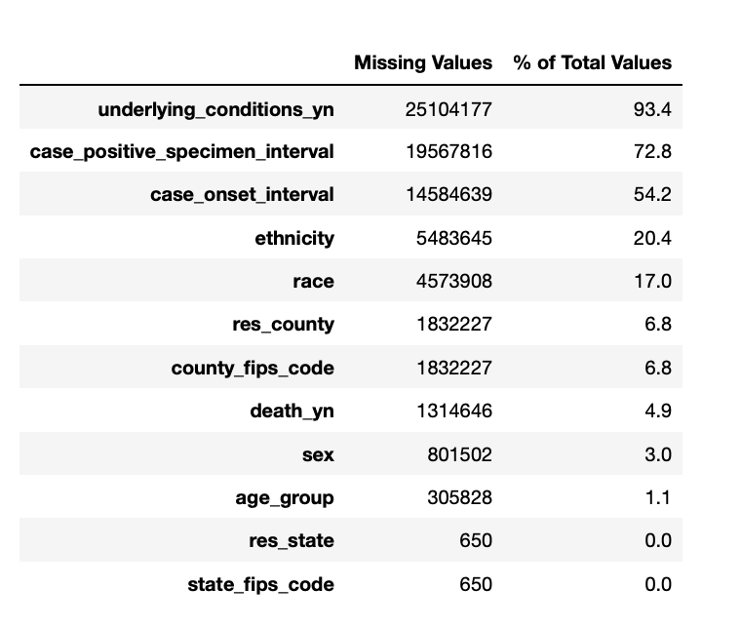
Missing Data
Our initial question changed based on available data
Even though this table shows percentage of Null values in each feature it does not contain the missing and unknown in each column

Slide 8
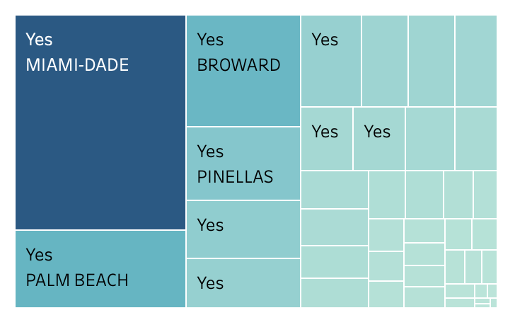
Description of the Analysis
Bias in Data
Underlying Conditions
Anything could qualify as an underlying condition
Where data was collected
We focused on Florida but there were counties that had no data collected
Charlotte county is a populated county but was completely missed
Phrasing
Phrasing in how features were collected played a big role in how our data story was told

Slide 9
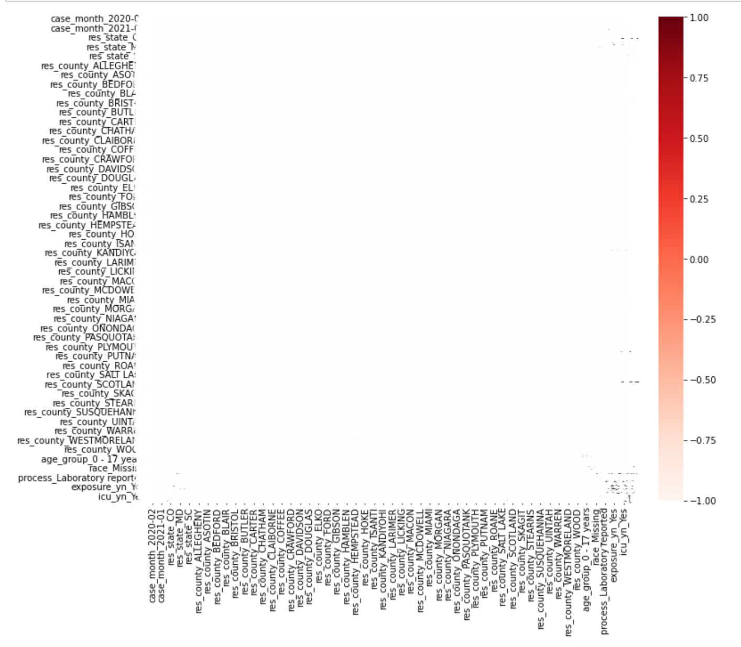
TOO Much Data
27 Million rows of data present
In each row was one of 19 features or columns
Narrowed down to using just Florida
Looking to see which features had little to no data missing

Slide 10

Age Groups X Covid-19 Death
0 - 17 years
18 - 49 years
50 - 64 years
65 + years
X

Slide 11
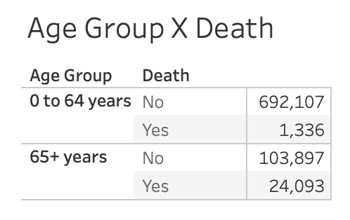
Data Scrubbing
Based on our findings we saw that we needed to split our age category into new buckets to accommodate the way the data showed
Originally there were very little deaths in each age bucket under 65+

Slide 12
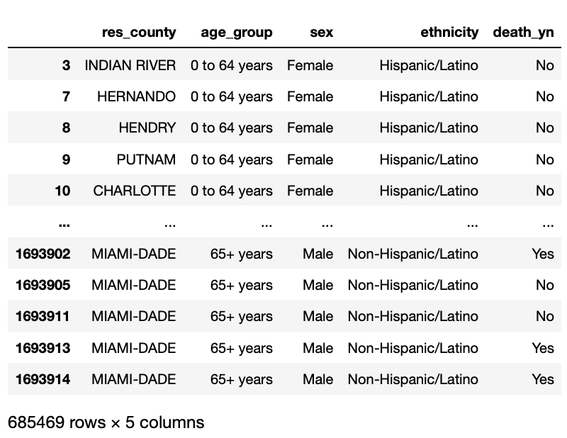
Narrowing our Scope
Deciding which Features to drop
Getting rid of all but 4 features age, sex, ethnicity, and county
Based on either lack of information or obvious inherent bias we dropped other features
Picking one State for focus
We decide to go with Florida for our state as we deemed it relevant and interesting to see what information we could extract from the data

Slide 13
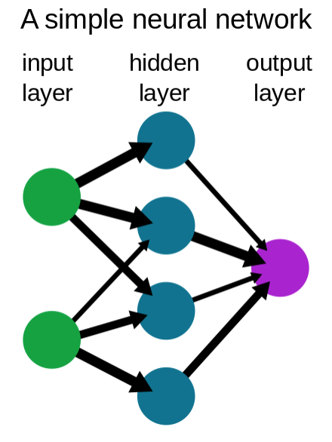
Neural Network Machine Learning Model
Reason chosen:
>Neural networks use algorithms than can reveal hidden relationships, pattens, and predictions on raw data and over time continuously learn and improve.
> Can handle large sets of data and suited to solve complex problems
> Have greater tolerance for messy data
Limits:
> Prone to overfitting
·
l

Slide 14
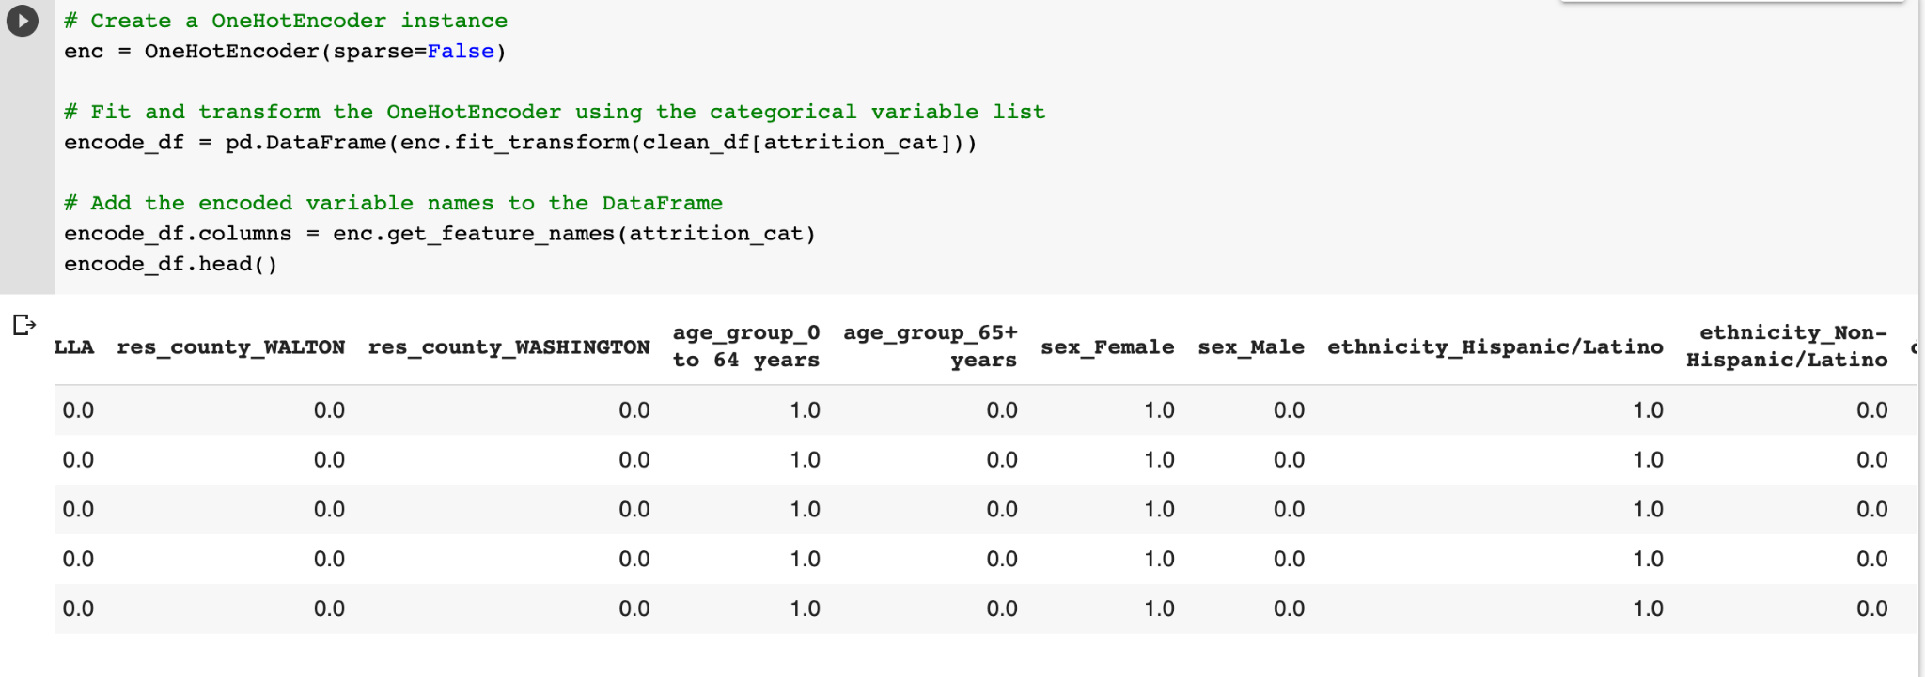
Preprocessing Steps for Neural Network Model
Imported final data set from AWS S3 bucket
Removed all remaining null values from columns
Use One-hot Encoder to group and encode categorical values

Slide 15
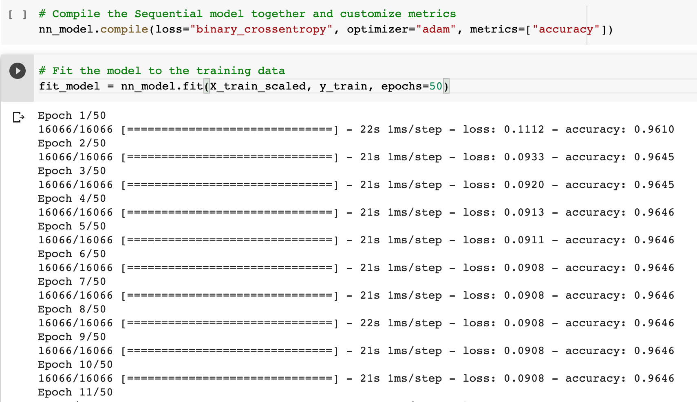
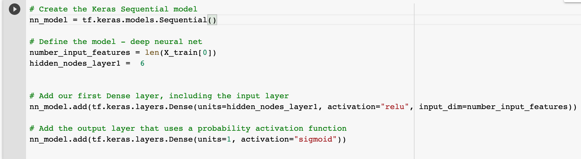
Model Training
Split data into features and target output
Y = death_yn_Yes
X = res_county, sex, ethnicity, age_group
Split data into training/testing dataset with sklearn

Slide 16
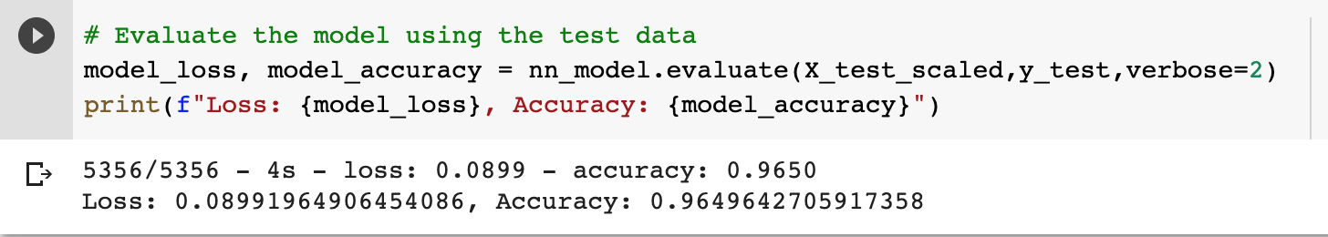
Model Evaluation
Initial accuracy was 97% with 0.1 loss with age_group and death
Current accuracy is 96% with loss 0.08 with added features of sex, ethnicity, county and age_group and death outcome

Slide 17
Case Fatality Rate
Case fatality rate refers to the proportion of patients with a given disease who will die from that disease (number of deaths/total number of Covid cases), which means the probability of death in a person who gets Covid.

Slide 18
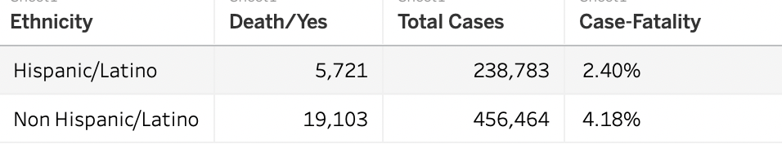
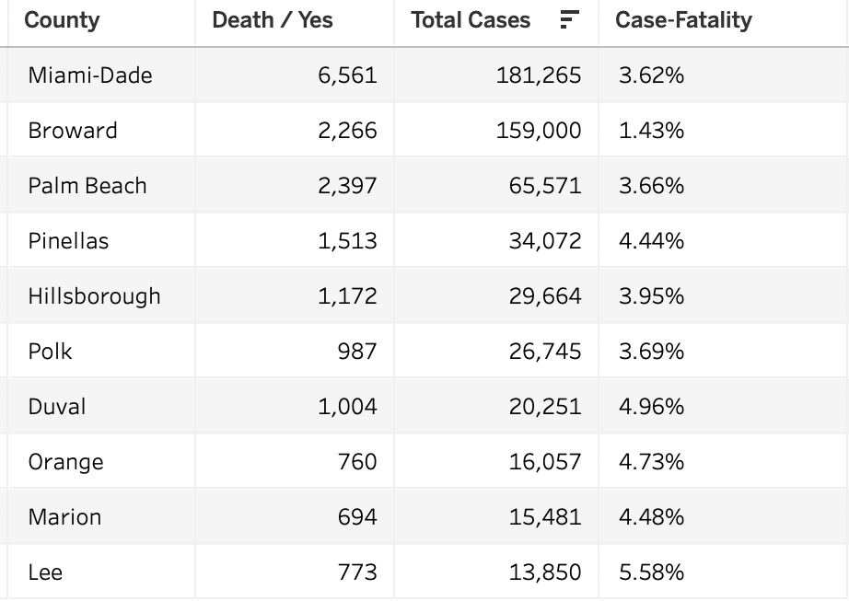
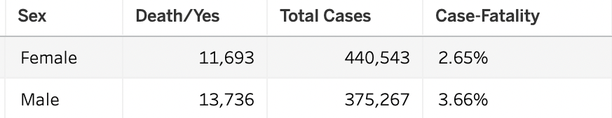
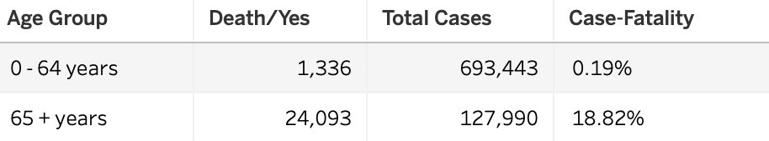
Case Fatality Rate

Slide 19
Conclusion
After comparing Case Fatality Rate between the groups we tried to identify potential risk factor for death. The Age Group shows a very large difference of the Case Fatality Rate.
After all, current data suggests that elderly is more at risk.
https://public.tableau.com/app/profile/susana.correia/viz/CaseFatalityRates_Covid_FL/CaseFatalityRates?publish=yes

Slide 20

Any Questions
Please feel free to
ask questions!

